Slide 1


<Sahar Zare>
<02/12/2023>

Slide 2

Outline
Executive Summary
Introduction
Methodology
Results
Conclusion
Appendix

Slide 3
Executive Summary
Summary of methodologies
Using API & web scraping for data collection
Data collection with web scraping
Data cleansing and preprocessing
EDA with SQL & Data visualization & interactive Plotly dashboards
Machine learning prediction
Summary of all results
Results for EDA & Data visualization
Interactive analysis
Results for predictive analytics

Slide 4
Introduction
Project background and context
It will be predicted if the first stages of Falcon 9 are usable again or not. so, we should be sure if the landing is successful or not. It is important to know the reusability of stages because the cost of the landing of other providers is about 165 million dollars however Space X spends about 62 and it will be useful for new entrants. the data will be collected from the website through API. the problem is classification supervised learning.
Problems you want to find answers
If the rocket will land successfully and which features show successful land
which features impact the processes

Slide 5

Section 1

Slide 6
Methodology
Executive Summary
Data collection methodology:
Data was collected from web scraping and using SpaceX API (open sources website)
Perform data wrangling
Categorical features converted to numerical by one hot encoding technique
Filling the missed value and removing outliers' data
Standardize the data set before making a split for training
Perform exploratory data analysis (EDA) using visualization and SQL
Perform interactive visual analytics using Folium and Plotly Dash
Perform predictive analysis using classification models
How to build, tune, and evaluate classification models

Slide 7
Data Collection
Data sets were collected by using a library of “get request” to the SpaceX API
We as a client connect to web service by API and the data as output transmit in the JSON format
It is needed to transform datatype from JSON to data frame by using Pandas
Regarding domain knowledge we can take the subset of the data frame
Explore new datasets to understand each column
Regarding domain knowledge we will remove rows with multiple cores and payloads
Converting the datatype of each column to Pandas format
Extracting new dataset from the previous data frame
Data collection from web scraping from wikipedia

Slide 8
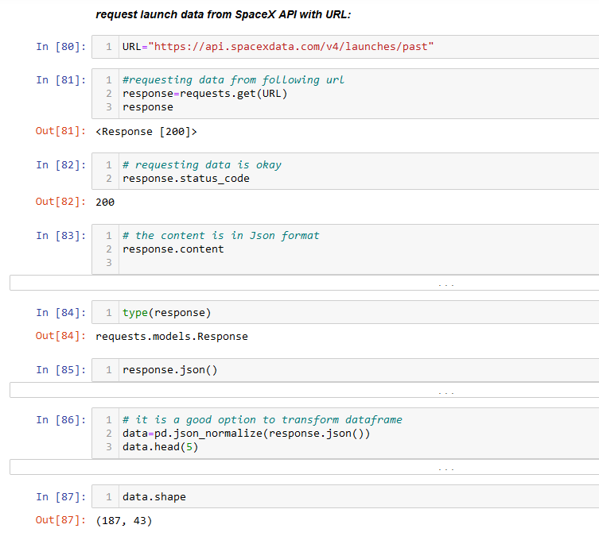
Data Collection – SpaceX API
Present your data collection with SpaceX REST calls using key phrases and flowcharts
The GitHub URL of the completed SpaceX API: https://github.com/saharzare/Initial_Projects/blob/main/spacex_Falcon9-API.ipynb
Place your flowchart of SpaceX API calls here

Slide 9
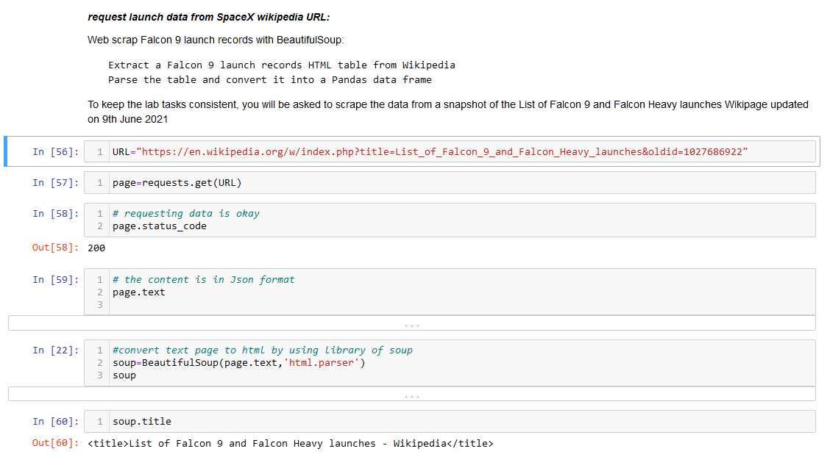
Data Collection - Scraping
Present your web scraping process using key phrases and flowcharts
The GitHub URL of the completed web scraping notebook: https://github.com/saharzare/Initial_Projects/blob/main/spacex_Falcon9-webScraping.ipynb
Place your flowchart of web scraping here

Slide 10
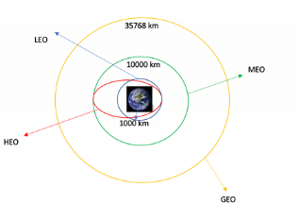
Data Wrangling
Perfome EDA to find the pattern in data
Figure out the number of launches at each site and the occurrence of each orbit
Convert data label to o or 1
GitHub URL of your completed data wrangling: https://github.com/saharzare/Initial_Projects/blob/main/labs-jupyter-spacex-Data%20wrangling%20(1)(1).ipynb

Slide 11
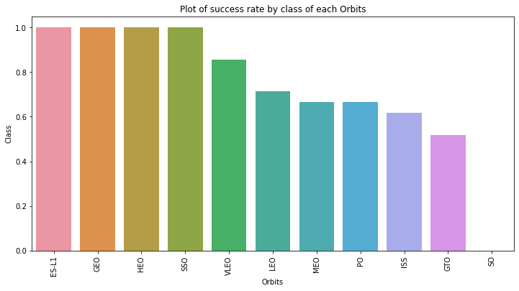
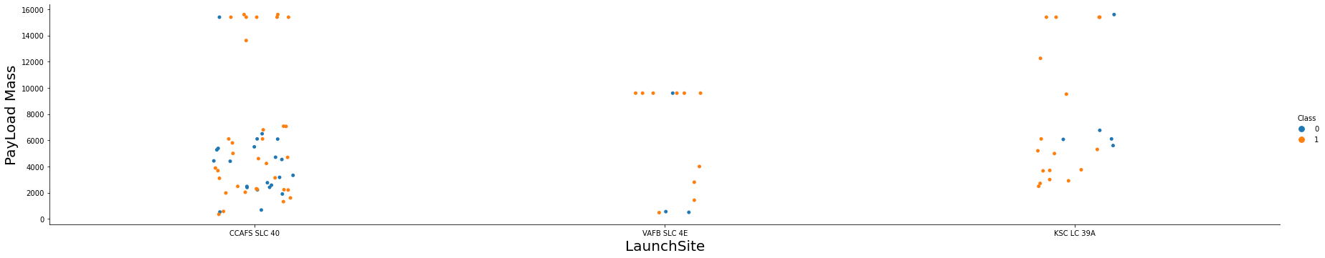
EDA with Data Visualization
There are some charts depicting the relationship between different features to define the patterns
The link of Github notebook
https://github.com/saharzare/Initial_Projects/blob/main/jupyter-labs-eda-dataviz%20(2).ipynb

Slide 12
EDA with SQL
load the table using the database console LOAD tool in DB2
Do exploratory data analysis with the query of SQL to get insights from data, including:
Display the names of the unique launch sites in the space mission
Display 5 records where launch sites begin with the string 'CCA'
Display the total payload mass carried by boosters launched by NASA (CRS)
Display average payload mass carried by booster version F9 v1.1
List the date when the first successful landing outcome in the ground pad was achieved
List the names of the boosters which have success in drone ships and have payload mass greater than 4000 but less than 6000
List the total number of successful and failed mission outcomes
List the names of the booster_versions which have carried the maximum payload mass. Use a subquery
List the records which will display the month names, failure landing_outcomes in drone ship ,booster versions, launch_site for the months in year 2015
Rank the count of successful landing_outcomes between the date 2010-06-04 and 2017-03-20 in descending order
GitHub URL of completed EDA with SQL notebook: https://github.com/saharzare/Initial_Projects/blob/main/EDA%20with%20SQL.ipynb

Slide 13
Build an Interactive Map with Folium
The launch success rate depends on many features like payload mass, orbit type, and the location and proximities of a launch site, i.e., the initial position of rocket trajectories. Finding an optimal location for building a launch site certainly involves many factors it is possible to discover by analyzing the existing launch site locations with answering the questions like:
Are all launch sites in proximity to the Equator line?
Are all launch sites in very close proximity to the coast?
create markers for all launch records. If a launch was successful (class=1), then we use a green marker and if a launch failed, we use a red marker (class=0)
Note that a launch only happens in one of the four launch sites, which means many launch records will have the exact same coordinate. Marker clusters can be a good way to simplify a map containing many markers having the same coordinate.
Here is a link to figure out the use of the Folium library in GitHub:
https://github.com/saharzare/Initial_Projects/blob/main/lab_jupyter_launch_site_location(1).ipynb

Slide 14
Build a Dashboard with Plotly Dash
Summarize what plots/graphs and interactions you have added to a dashboard
Explain why you added those plots and interactions
Add the GitHub URL of your completed Plotly Dash lab, as an external reference and peer-review purpose

Slide 15
Predictive Analysis (Classification)
Raw dataset
We load the cleaned data frames by using the libraries of pandas and numpy and transformed data to standard one and split data to train and test datasets.
We train our models with training datasets and tuned hyperparameters
We import confusion metrics from the sklearn library to check the accuracy of models to find the best practiced model
GitHub URL of the completed predictive analysis lab:
https://github.com/saharzare/Initial_Projects/blob/main/SpaceX_Machine%20Learning%20Prediction_Part_5%20(2).ipynb
Data preprocessing
Training set
Test set
ML models
Predicted outcomes

Slide 16
Results
Exploratory data analysis results
Interactive analytics demo in screenshots
Predictive analysis results

Slide 17

Section 2

Slide 18
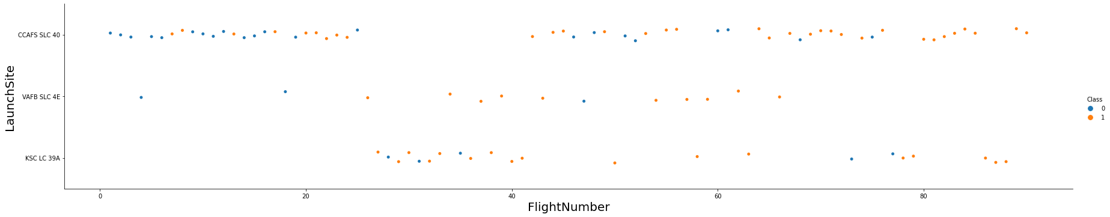
Flight Number vs. Launch Site
The more Flight Number the higher chance of successful landing at the Launch Site.
33% of total successful landing is CCAFS SLC 40
21% of KSC LC 39A has the probability of class 1
12% of KSC LC 39A has the probability of class 1

Slide 19
Payload vs. Launch Site
The higher the payload mass the greater probability to land successfully

Slide 20
Success Rate vs. Orbit Type
There is more chance for the orbits of ES-L1, GEO, HEO and SSO rather than other orbits to land successfully

Slide 21
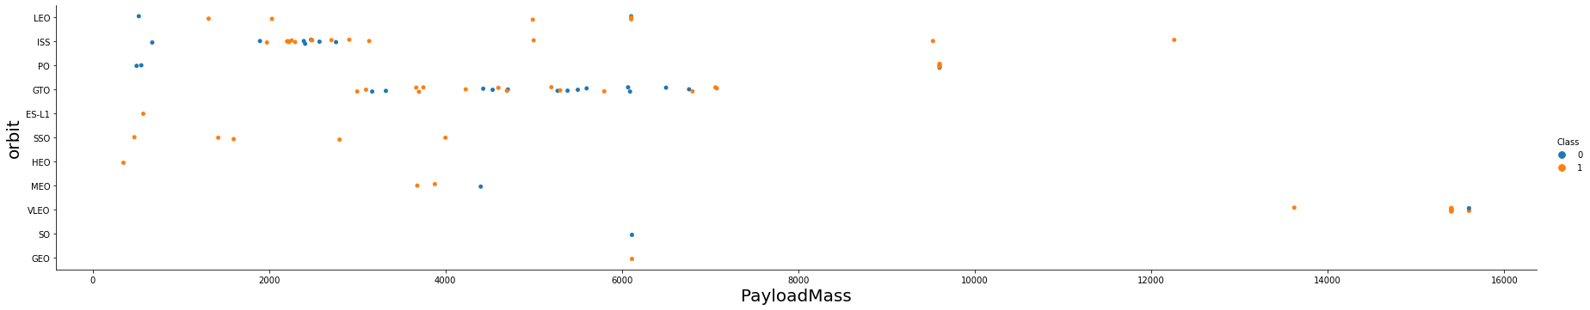
Payload vs. Orbit Type
For high payload mass the successful ladings are related to PO and VELO

Slide 22
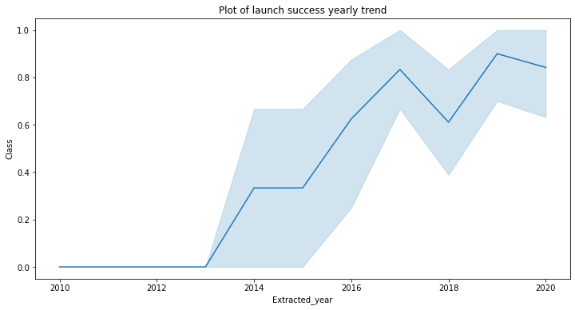
Launch Success Yearly Trend
The graph illustrates the growth trend in launch success between 2013 to 2020.

Slide 23
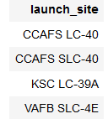
All Launch Site Names
The names of the unique launch sites are presented by use of distinct in SQL

Slide 24
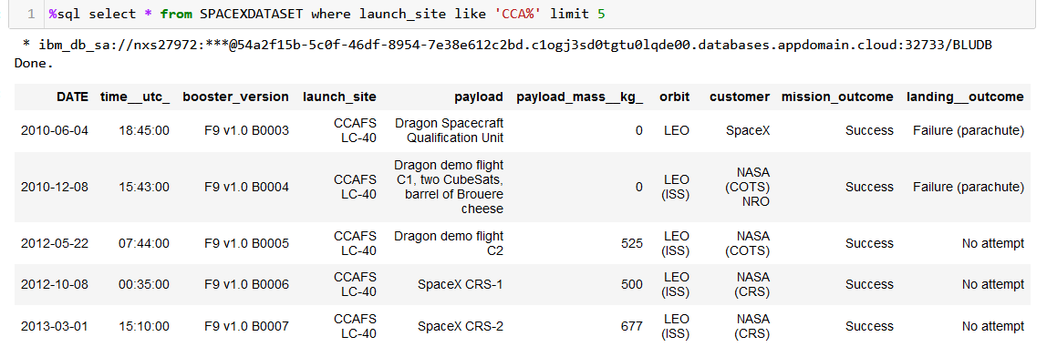
Launch Site Names Begin with 'CCA'
We Find 5 records where launch sites begin with `CCA`

Slide 25
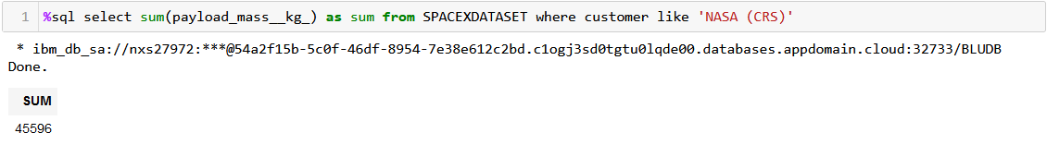
Total Payload Mass
We Calculate the total payload carried by boosters from NASA

Slide 26
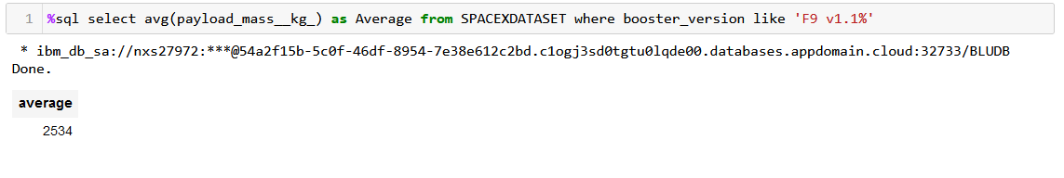
Average Payload Mass by F9 v1.1
We Calculate the average payload mass carried by booster version F9 v1.1

Slide 27
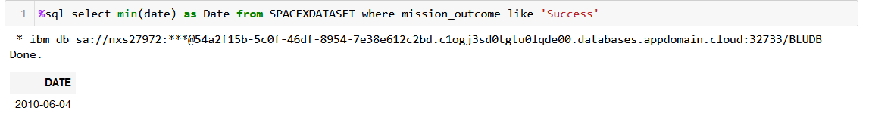
First Successful Ground Landing Date
We find the dates of the first successful landing outcome on the ground pad

Slide 28
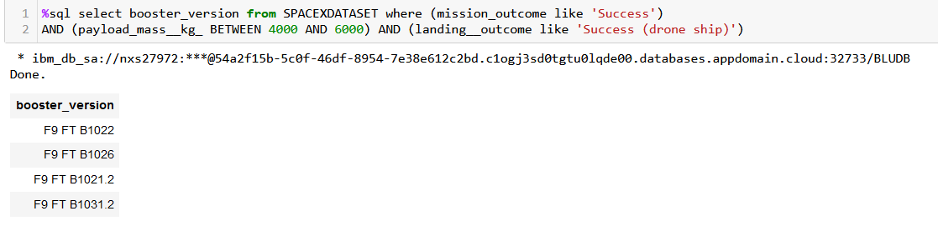
Successful Drone Ship Landing with Payload between 4000 and 6000
List the names of boosters which have successfully landed on drone ship and had payload mass greater than 4000 but less than 6000

Slide 29
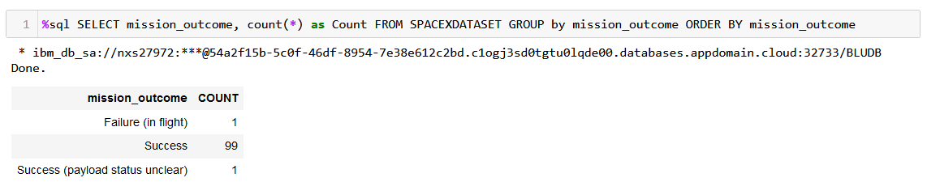
Total Number of Successful and Failure Mission Outcomes
We calculate the total number of successful and failed mission outcomes

Slide 30
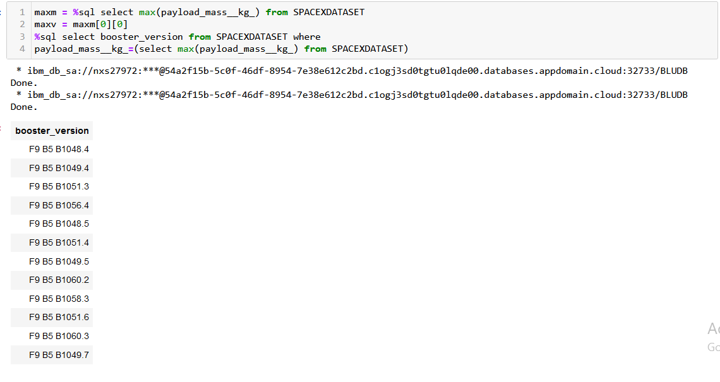
Boosters Carried Maximum Payload
List the names of the booster which have carried the maximum payload mass

Slide 31
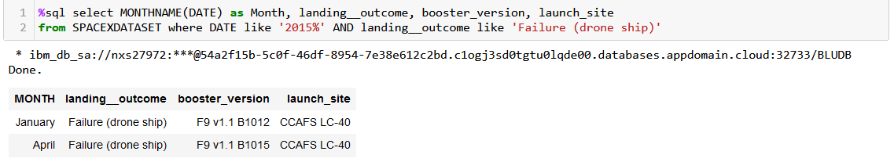
2015 Launch Records
List the failed landing_outcomes in drone ship, their booster versions, and launch site names for in year 2015

Slide 32
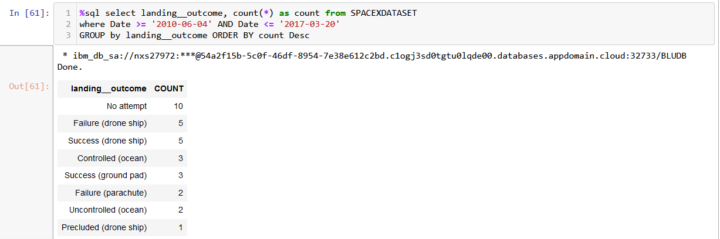
Rank Landing Outcomes Between 2010-06-04 and 2017-03-20
Rank the count of landing outcomes (such as Failure (drone ship) or Success (ground pad)) between the date 2010-06-04 and 2017-03-20, in descending order

Slide 33

Section 3

Slide 34
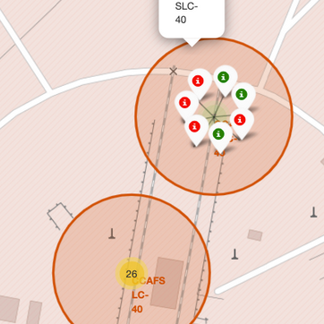
Lunch sites markers
It is easy to identify which launch sites have relatively high success rates from the color-labeled markers in marker clusters

Slide 35
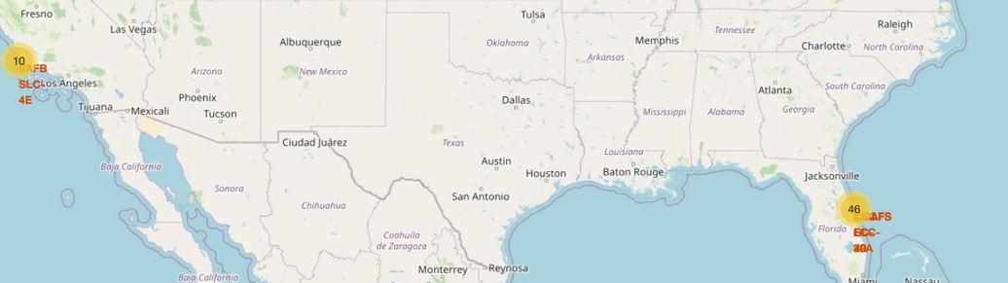
After you plot distance lines to the proximities, we understand the following points easily:
The launch sites are not near railways.
The launch sites near the coastline.
The launch sites keep a certain distance away from cities.

Slide 36

Section 4

Slide 37
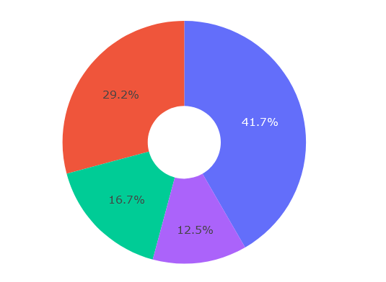
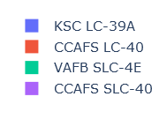
Dash plotly
The most successful lunch site for landing is KSC LC-39A

Slide 38
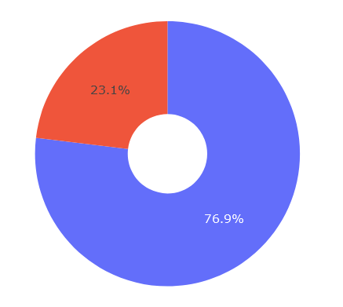

Successful lunches
From the landing site of KSC LC-39A more than 70% are in class 1 category

Slide 39

Section 5

Slide 40
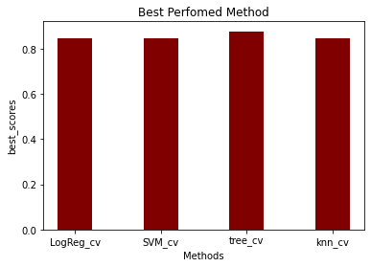
Classification Accuracy
The best score for the models which we trained and implemented is related to the Tree algorithm, with a score of 88%

Slide 41
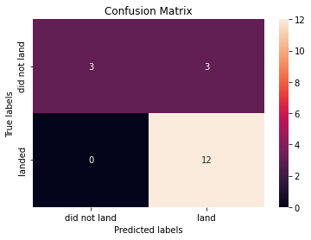
Confusion Matrix
The major diameter figures out the True positive and False negative, meaning that the correct prediction for successful and unsuccessful landing
The minor diameter represents a false prediction of an unsuccessful landing and false prediction of successful landing

Slide 42
Conclusions
Launch Site The tree classifier has the best score for training fit model
There is more chance for the orbits of ES-L1, GEO, HEO and SSO rather than other orbits to land successfully
The higher the payload mass the greater probability to land successfully
The more Flight Number the higher chance of successful landing at the

Slide 43
Appendix
Include any relevant assets like Python code snippets, SQL queries, charts, Notebook outputs, or data sets that you may have created during this project

Slide 44


